Slide 1
Name : NIRMAL THOMAS
Course : BSc Data Science
Semester : II

Slide 2
GGPLOT2
ggplot2 is a plotting package that provides helpful commands to create complex plots from data in a data frame.

Slide 3
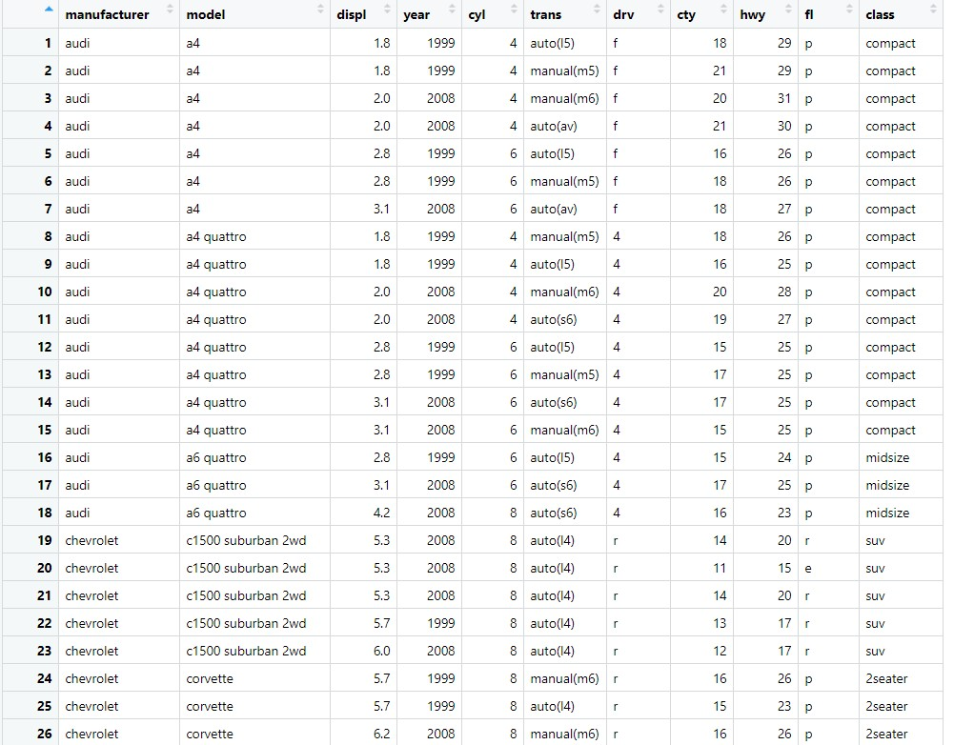
Dataset : MPG (Source: R inbuild dataset Library)

Slide 4
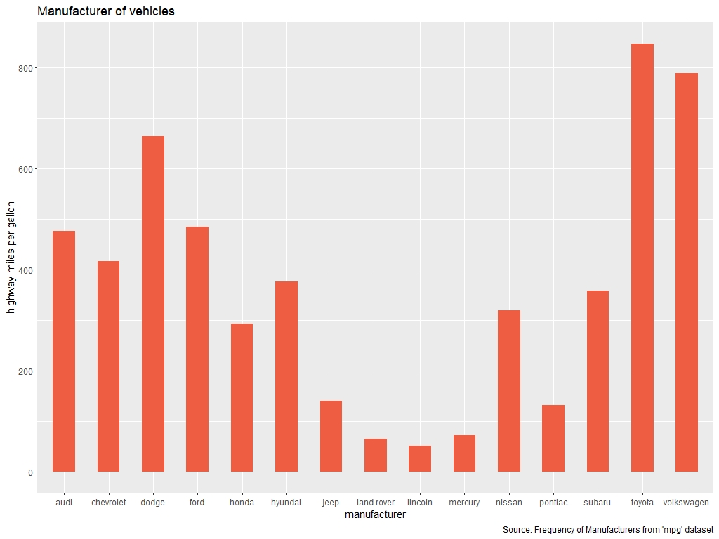
Bar Plot

Slide 5
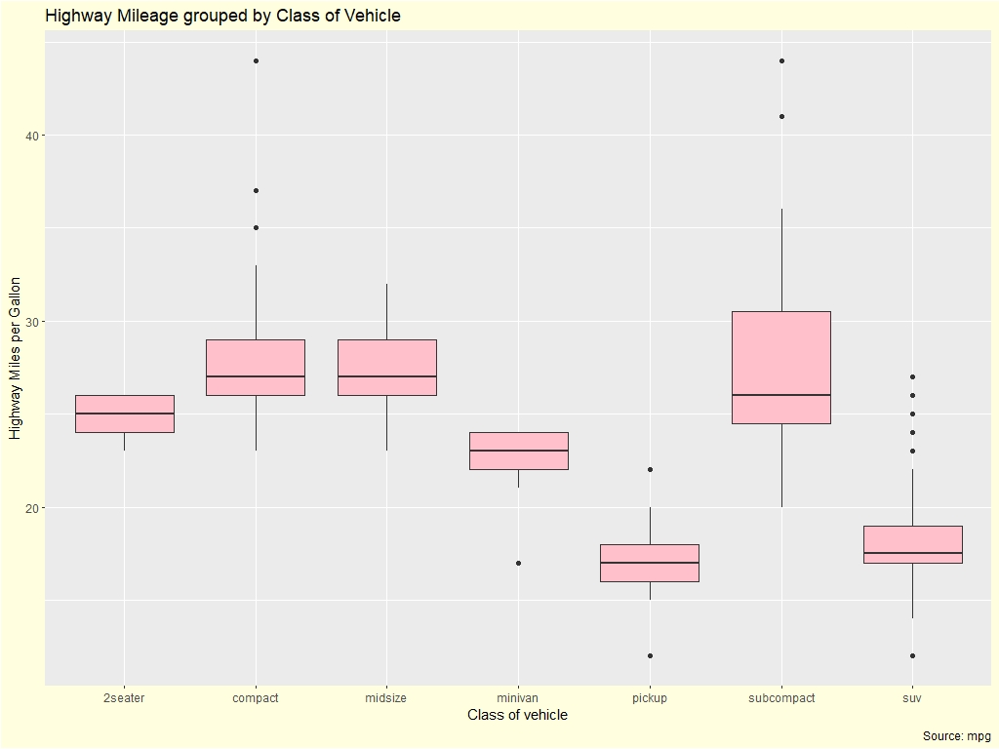
Box Plot

Slide 6
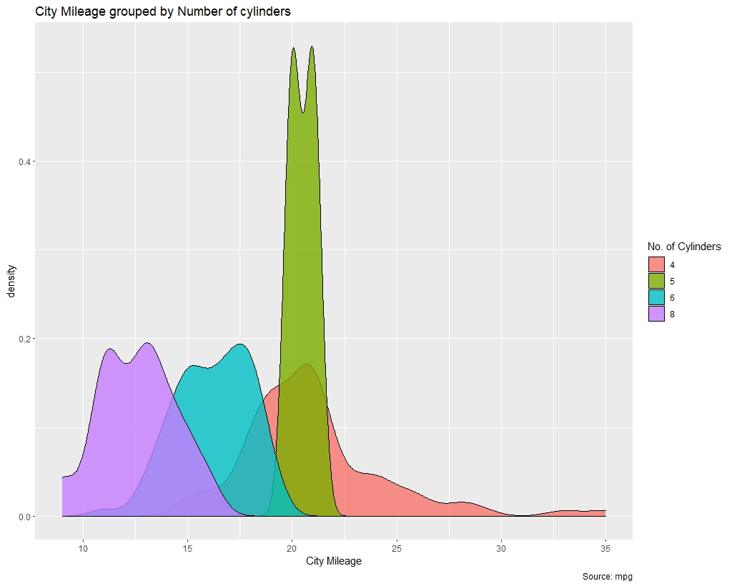
Density Plot

Slide 7
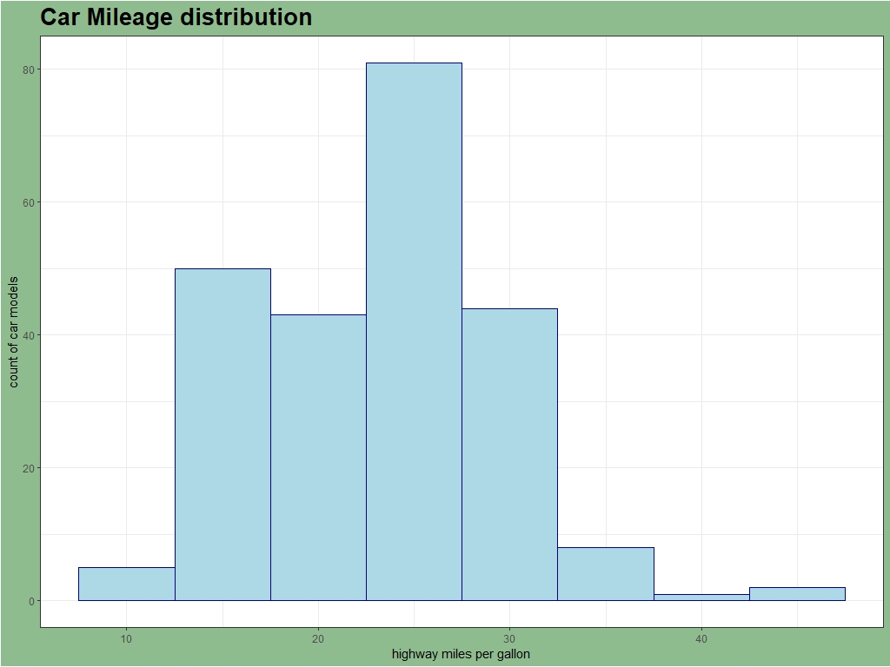
Histogram

Slide 8
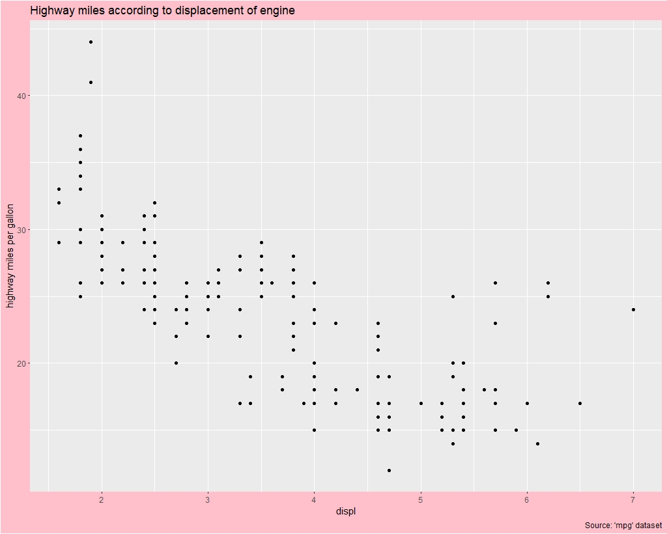
Scatter Plot

Slide 9
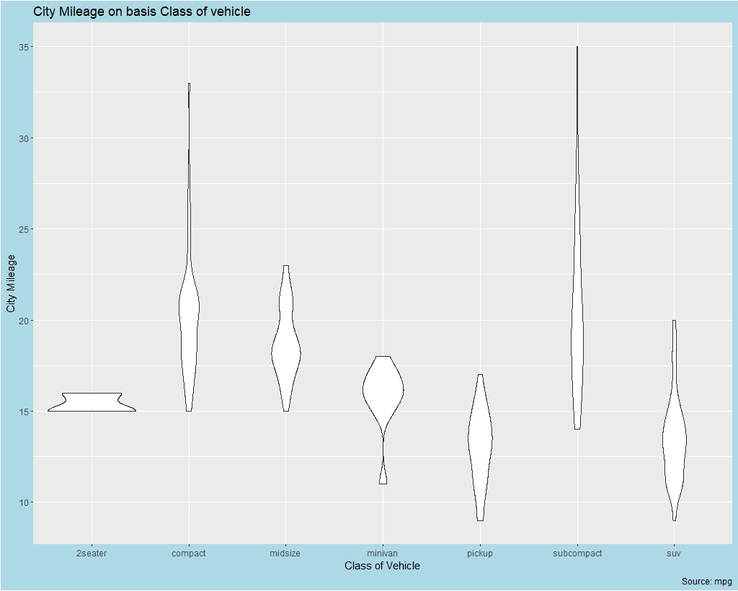
Violin Plot

Slide 10
Bootstrap Testing

Slide 11
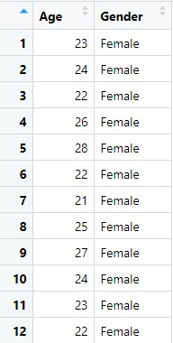
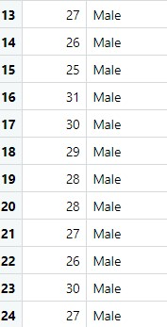
Dataset

Slide 12
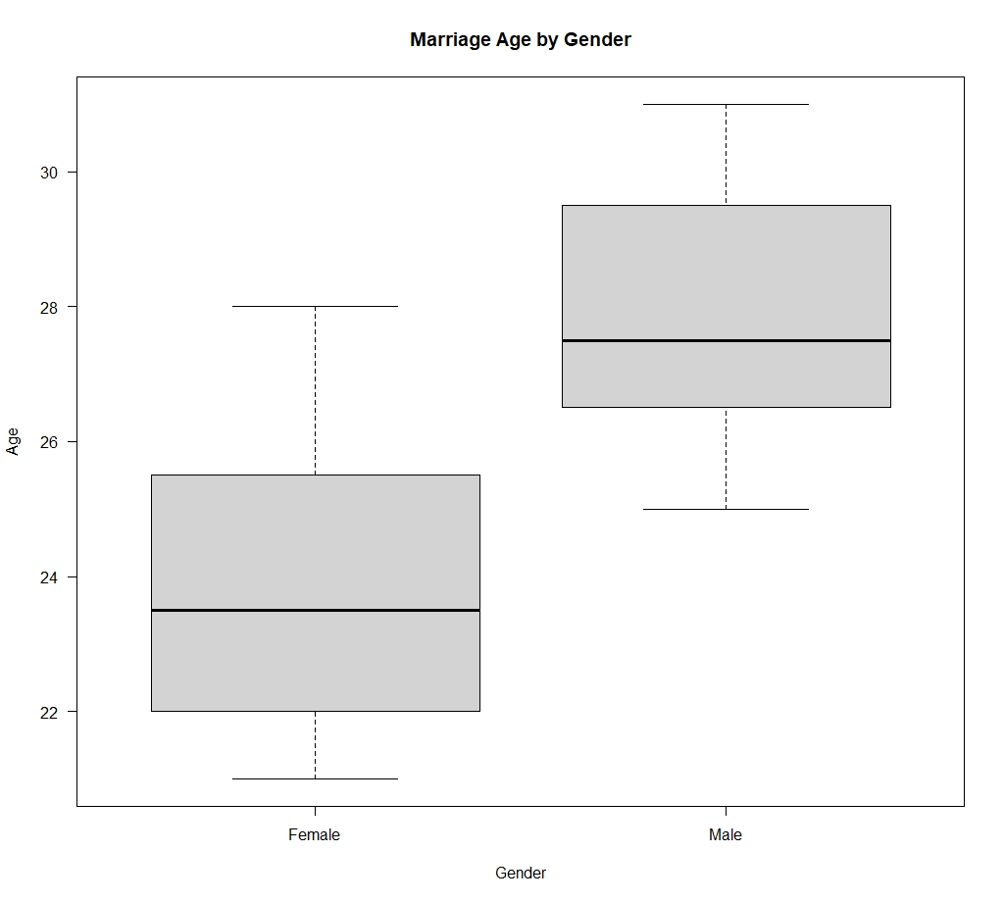
Boxplot of the Dataset

Slide 13
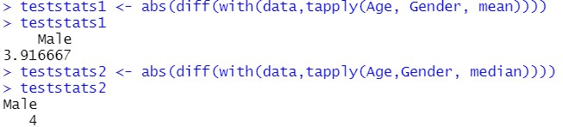

Slide 14
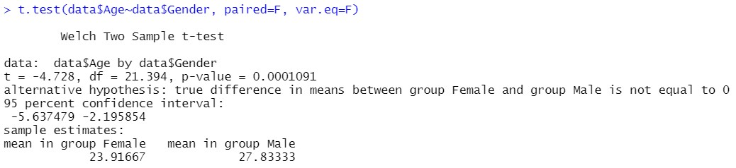
T-Test

Slide 15
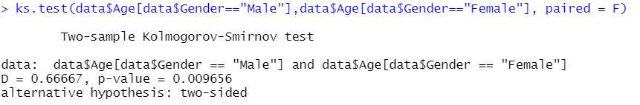
Kolmogorov – Smirnov Test

Slide 16
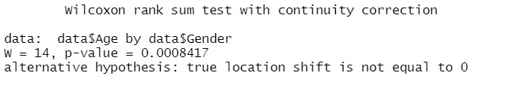
Wilcoxon rank-sum test

Slide 17
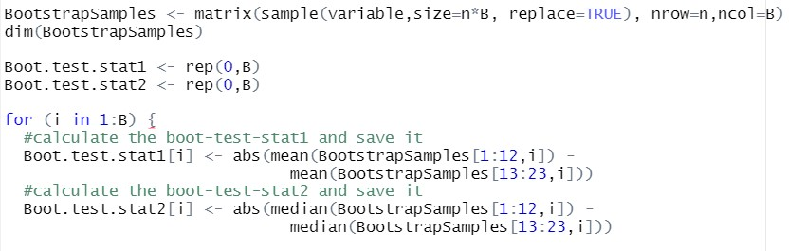
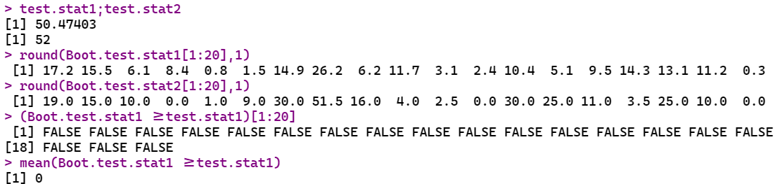
Bootstrap Testing

Slide 18

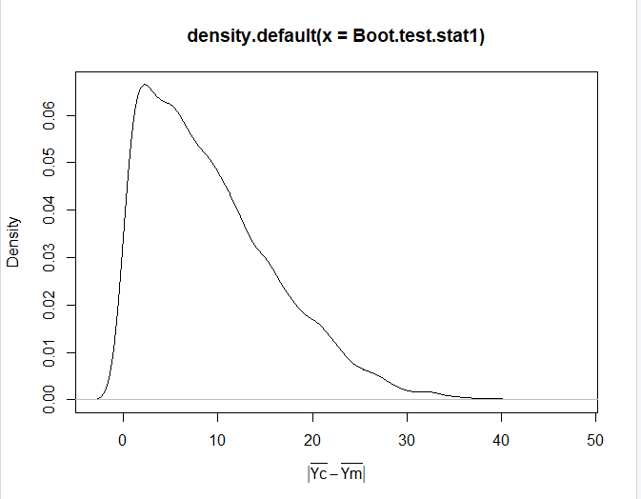
Density Plot

